Slide 1
Prediction modeling applied to non-cancerous genitourinary conditions
Jim Hokanson, PhD
Assistant Professor
Biomedical Engineering
@JimHokanson

Slide 2
Goal: Predict how individuals will respond to therapy (i.e., personalized medicine)
State of the Field: Try therapies until something works
(i.e., not personalized medicine)
slides at jimhokanson.com

Slide 3
How do we move towards our goal?
slides at jimhokanson.com

Slide 4
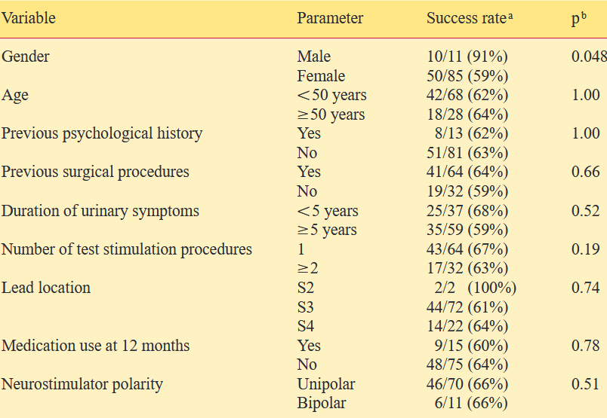
One Approach, Risk/Prediction Factors
Possible SNM factors
Factors associated with success or failure
Janknegt et al. 2001 European Urology
slides at jimhokanson.com

Slide 5
Another example from the ROSETTA study
Factors associated with Botox and sacral neuromodulation success
Richter et al. 2017 J. Urology
slides at jimhokanson.com

Slide 6
Transitioning to Prediction Modeling
Traditional risk/prediction factors
Prediction Modeling
Onus on clinician to process and integrate knowledge. Difficult for one study. Impossible for many?
Model provides patient specific probabilities of outcomes
Model 1
(Botox)
90% chance
of success
with Botox
Model 2
(Botox AE)
30% chance
of UTI
with Botox
1
Patient’s characteristics for modeling
Age: 70
BMI: 33
FCI: 3
Model 3
(SNM)
60% chance
of success
with SNM
1) http://www.likar.info/urology/article-72869-uchashhennoe-mocheispuskanie-bez-boli-ishhem-prichinu/
slides at jimhokanson.com

Slide 7
Factors vs. Prediction Models
Can use similar modeling approach but often prediction models focus foremost on getting an accurate and generalizable model.
Original Model
(e.g. logistic regression)
Improved Model
(Better accuracy)
Possible “improved” modeling approaches
Logistic regression with interaction terms or regularized regression
Random forests
Neural network
Support vector machine
etc.
Success
Failure
Lots of errors
Treatment Success
Treatment Failure

Slide 8
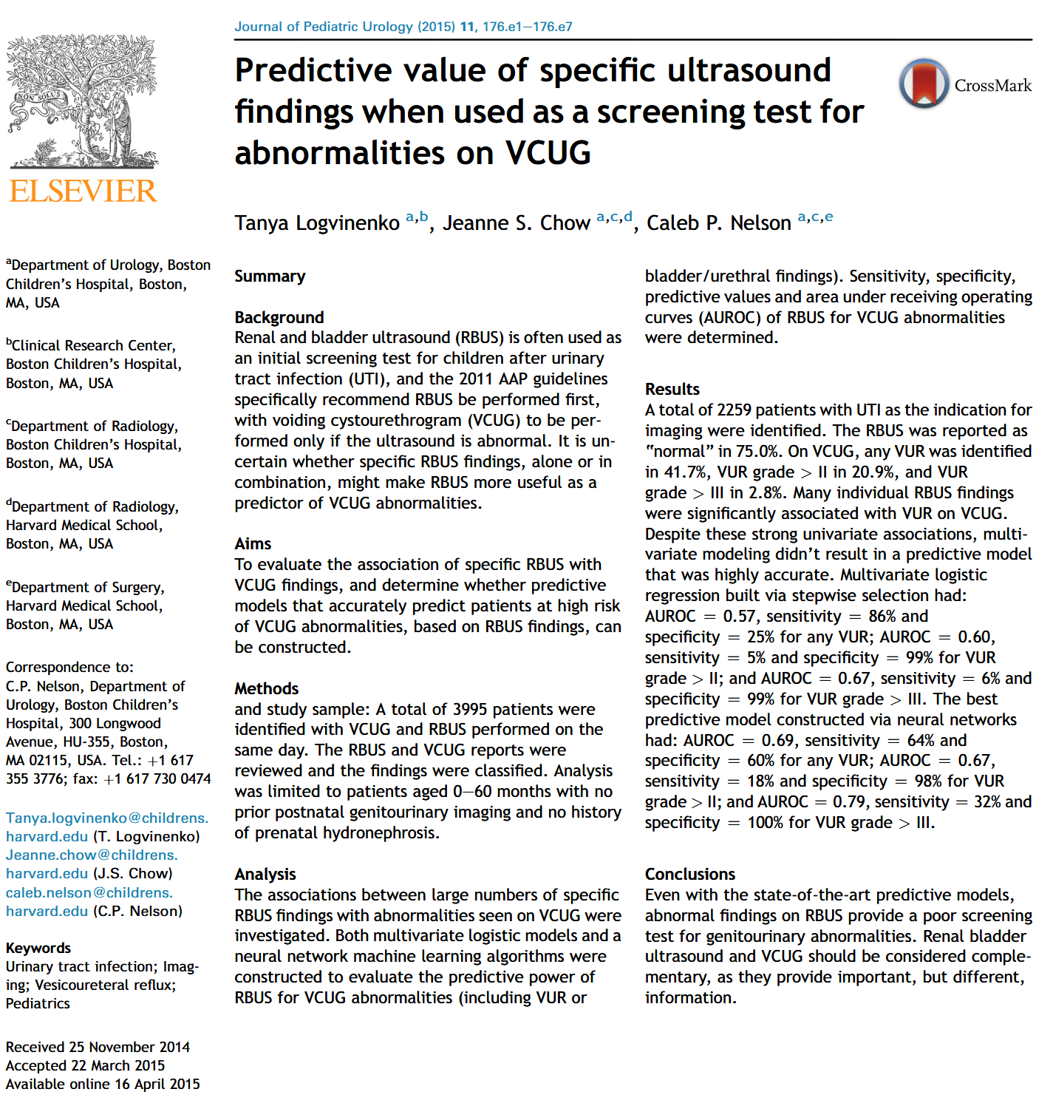
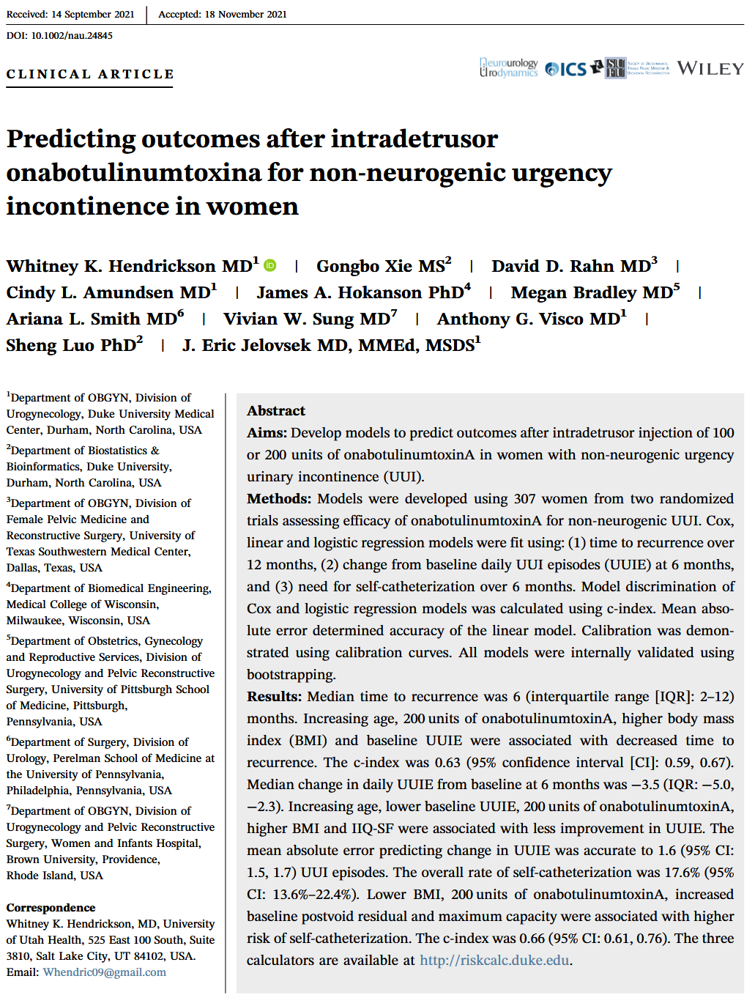
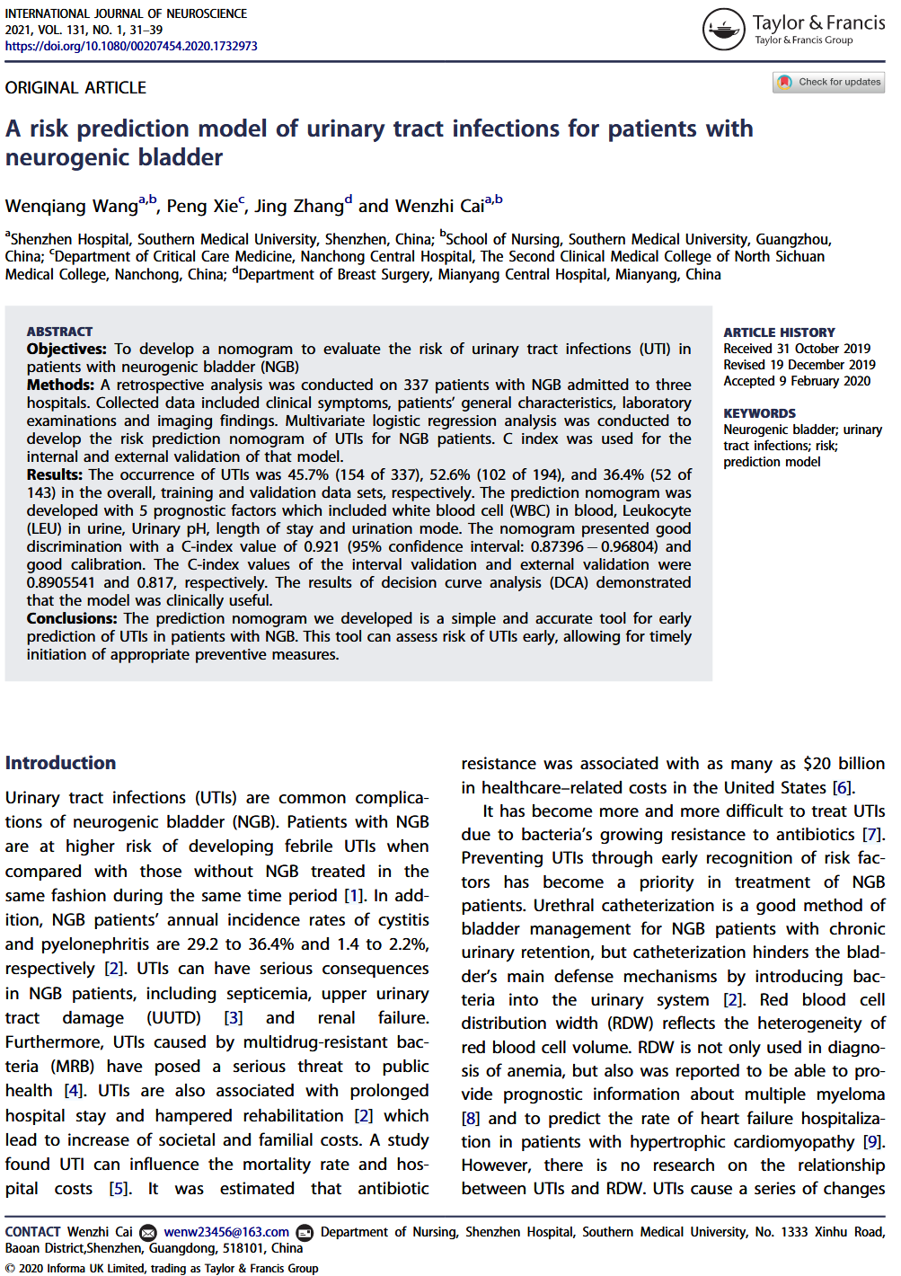
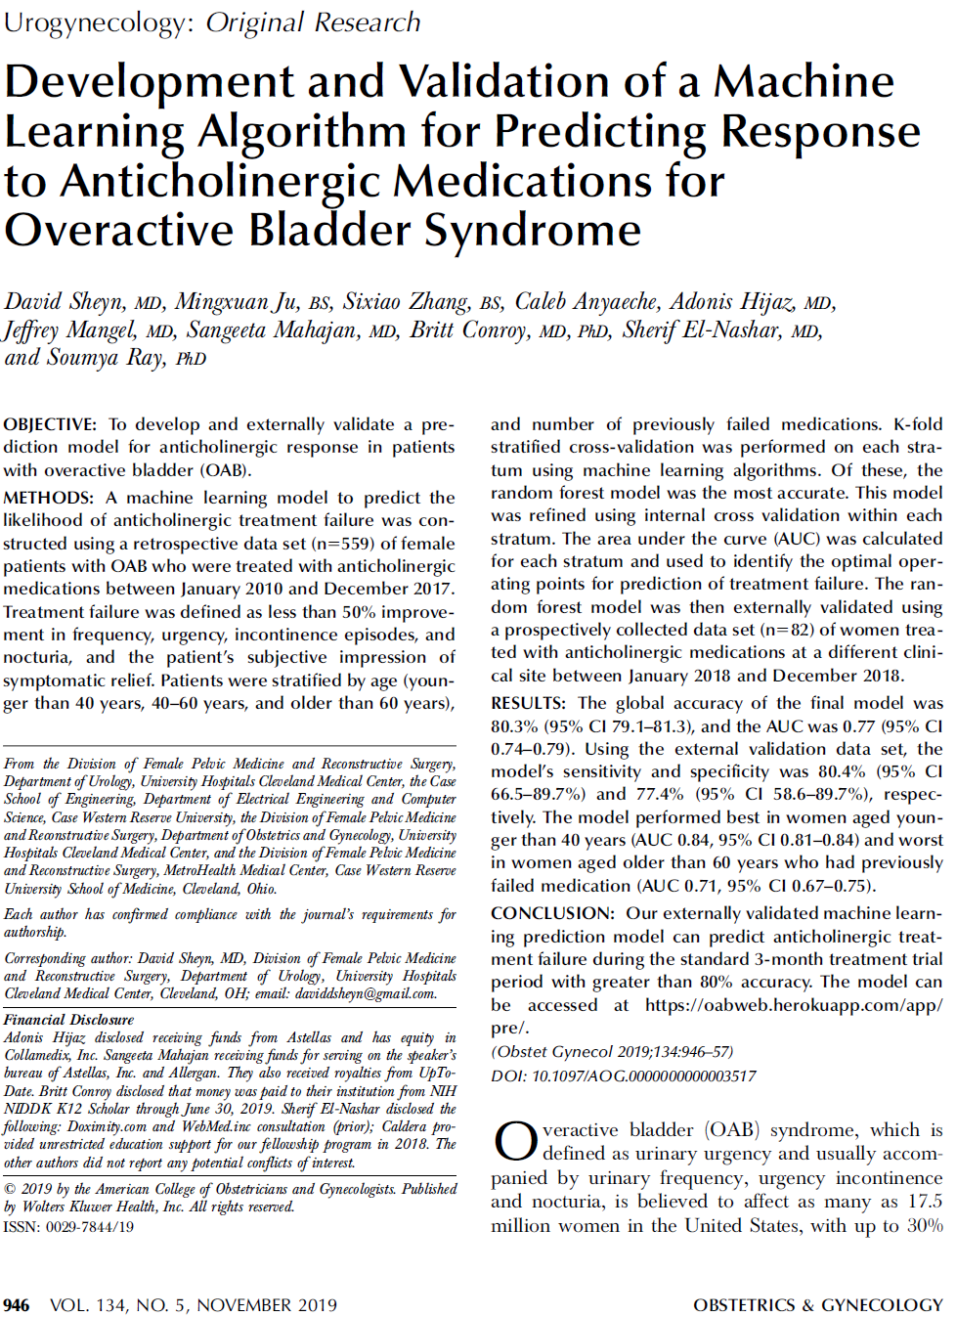
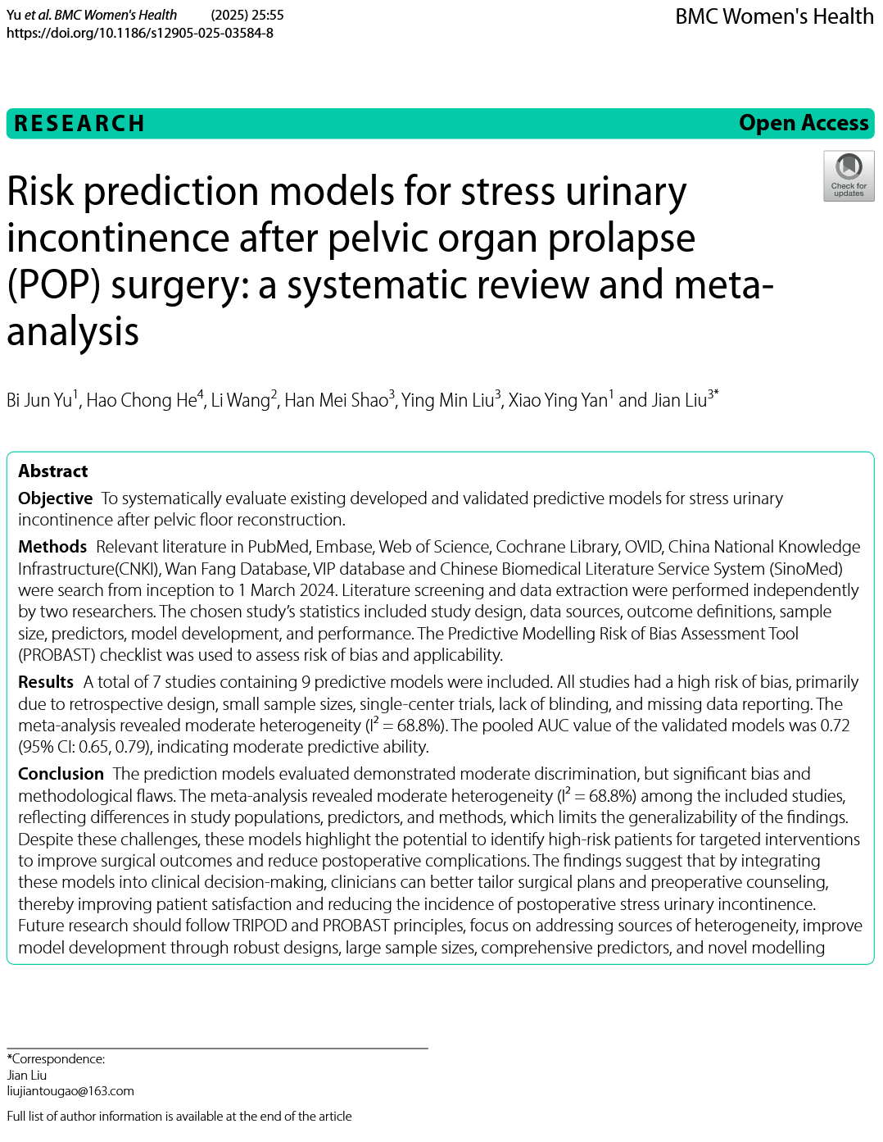
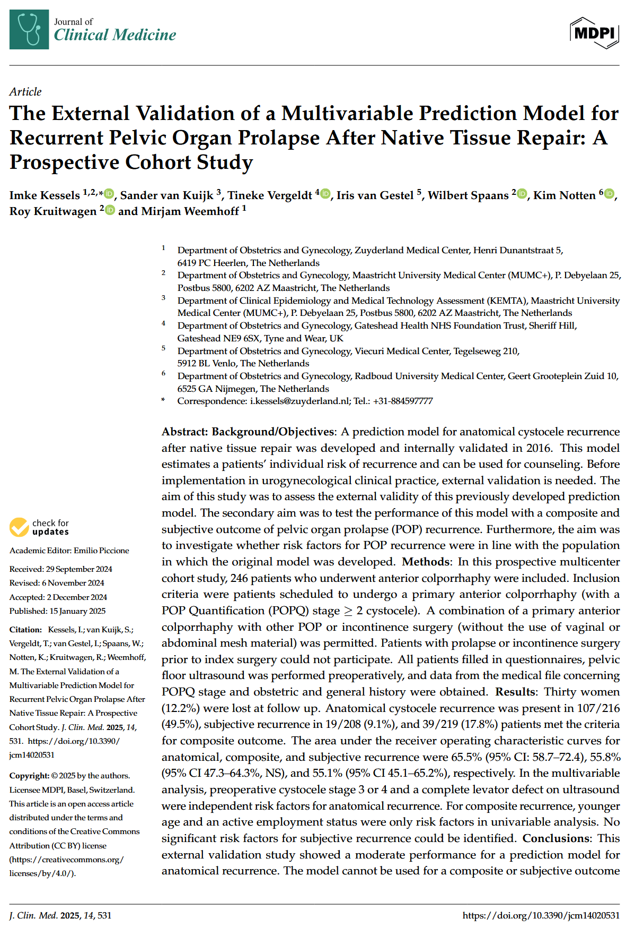
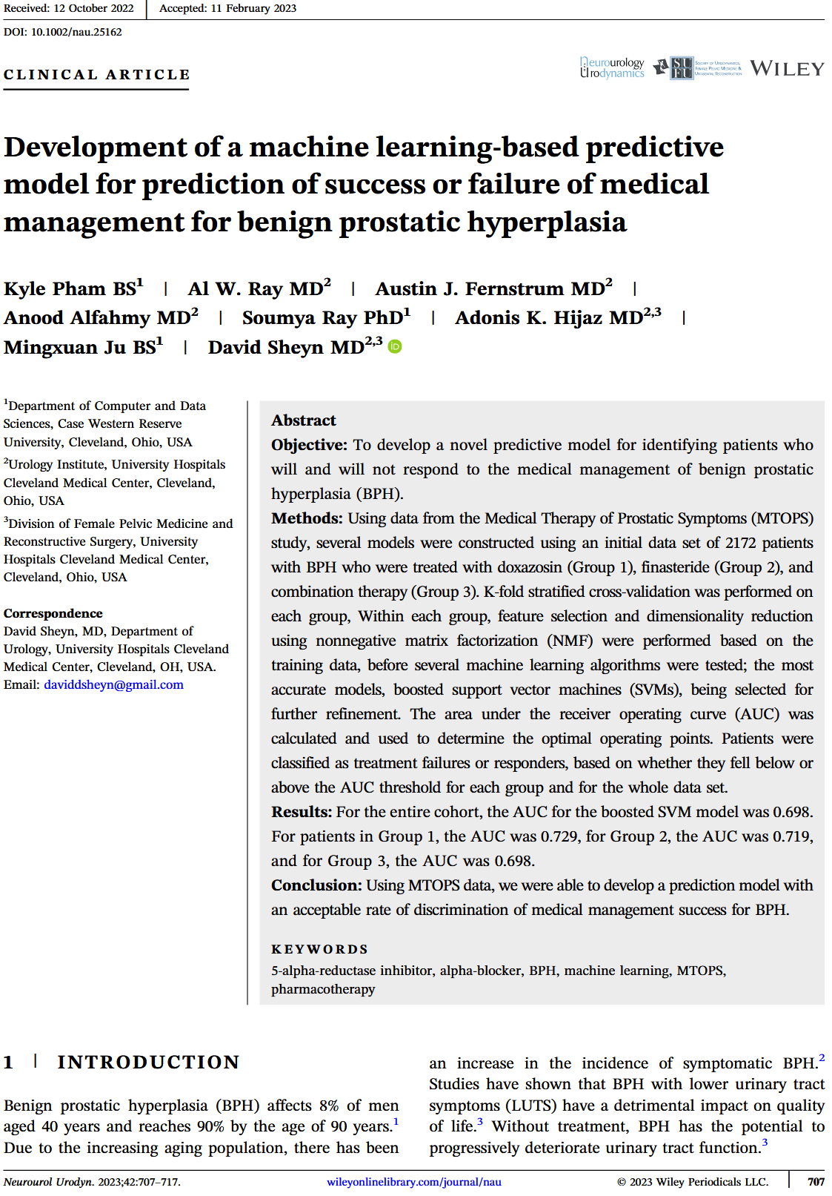

Slide 9
Things to Know: 1) Discrimination performance for binary classification (e.g., success or failure, adverse event or not)
Discrimination: how well can we tell the groups apart?
Metric: C-index or Area Under the Curve (AUC), 0.5 (chance) to 1 (perfect)
No Separability (Poor Model)
Good Discrimination
Perfect Discrimination
0
P(success)
1
0
P(success)
1
0
P(success)
1
failure
success
AUC=0.5
AUC=0.8
AUC=1
failure
success
failure
success
ROC Curve
ROC Curve
AUC=1
TPR (Sensitivity)
TPR (Sensitivity)
Chance
line
TPR (Sensitivity)
AUC=0.5
Chance
line
AUC=0.80
FPR (1 – Specificity)
FPR (1 – Specificity)
FPR (1 – Specificity)
https://www.datasciencecentral.com/roc-curve-explained-in-one-picture/
Notes:
https://www.datasciencecentral.com/roc-curve-explained-in-one-picture/

Slide 10
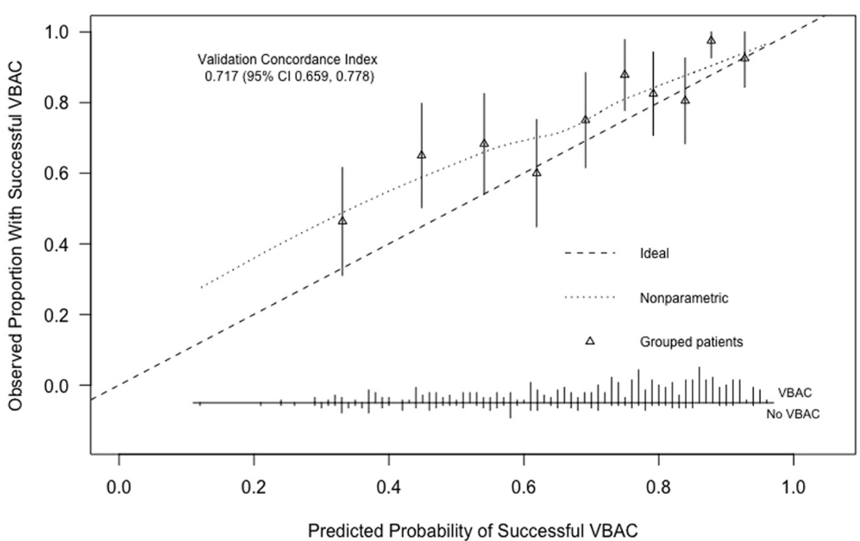
Things to Know: 2) Accuracy of probabilities for binary classification
Calibration – for a given probability estimate, how accurate is that value?
Often visually inspected, not quantified.
1
C-Index/AUC: 0.72
0.8
Model is pessimistic at 40% (actual is closer to 55% success)
0.6
Observed proportion with successful VBAC
VBAC: vaginal birth after cesarean (on subsequent pregnancy)
0.4
ideal
smoothed fit of observed
0.2
grouped patients
0
0
0.2
0.4
0.6
0.8
1
Predicted Probability of Successful VBAC
Grobman et al. 2007 O&G, Harris et al. 2019 AJOG

Slide 11
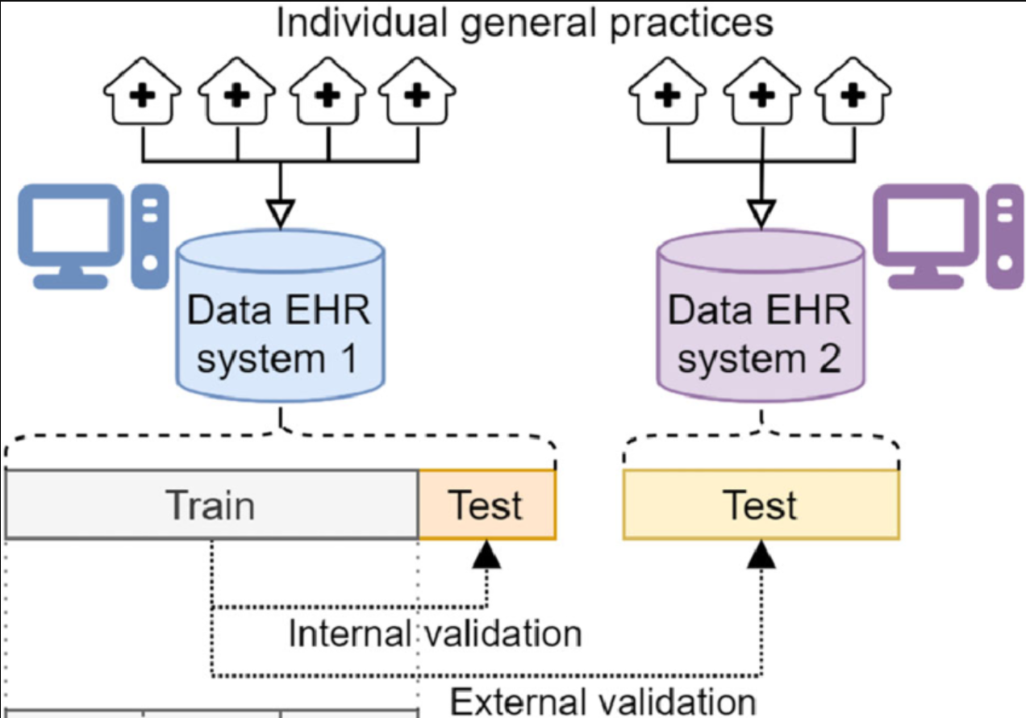
Things to Know: 3) Internal vs External Validation
Internal validation: Repeat testing of various models on various subsets of the data.
Possible overfitting (thus failing to generalize to new data)
External validation: tests a fixed model on a different dataset
Less likely to overfit
Stated performance more believable
Seinen et al. 2023 JAMIA
mathworks.com/discovery/overfitting.html

Slide 12
Things to Know: Other Considerations
4) Inclusion/Exclusion Criteria: generalizability?
5) Data Collection Settings: e.g., academic medical centers, country (e.g. US vs outside US), generalizability?
6) Feasibility
measure 100 things like done for RCT?
Only 5 measurements? Are these 5 feasible?
7) Conclusion/Goal:
Model ready for deployment?
Proof of principle – more work needed
Failed model
slides at jimhokanson.com

Slide 13
Example Prediction Models
Regression problem,
(R² goes from 0, chance, to 1, perfect)
Hendrickson et al. (Jelovsek) 2021 NAU – Botox for UUI
ROSETTA & ABC trial data, internal validation
Prediction: time to symptom recurrence/reinjection, C-Index = 0.63
Prediction: Need to catheterize over 6 months, AUC=0.66
Prediction: Change in incontinence episodes at 6-months, R²=0.25
Issues: Moderate performance, lack of external validation, use of RCT population
Pham et al. (Sheyn) 2023 NAU – Drugs for BPH
MTOPS trial data, internal validation
Prediction: treatment success, AUC=0.70
Issues: Moderate performance, lack of external validation, use of RCT population
Sheyn et al. 2019 Obstet. & Gynecol. – Anticholinergics for OAB
local data, internal and external validation (second Cleveland site)
Prediction: subjective success, AUC_internal = ~0.76, AUC_external = ~0.77
Issues: external validation used local site (ability to generalize elsewhere?)

Slide 14
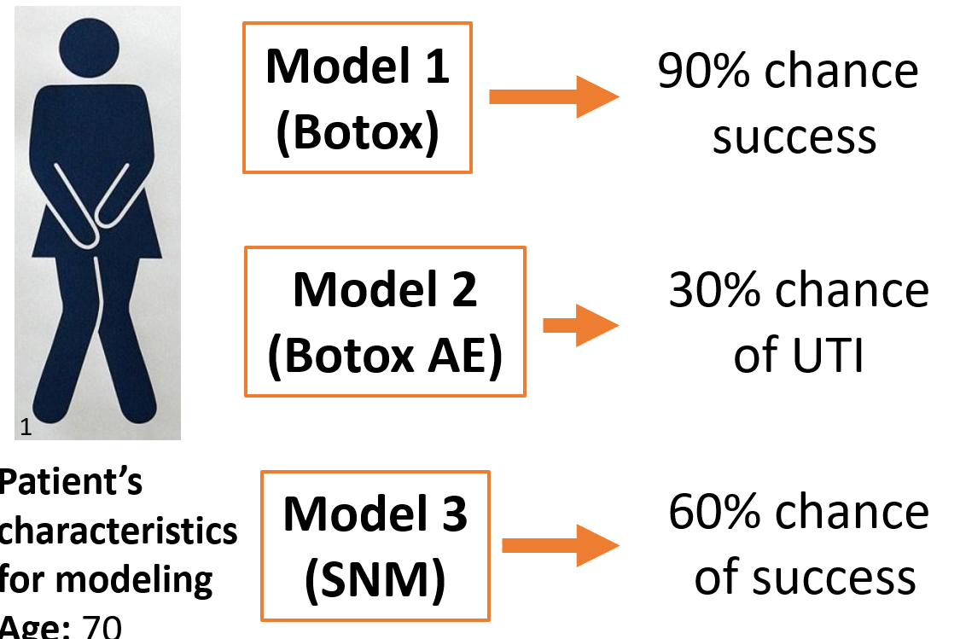
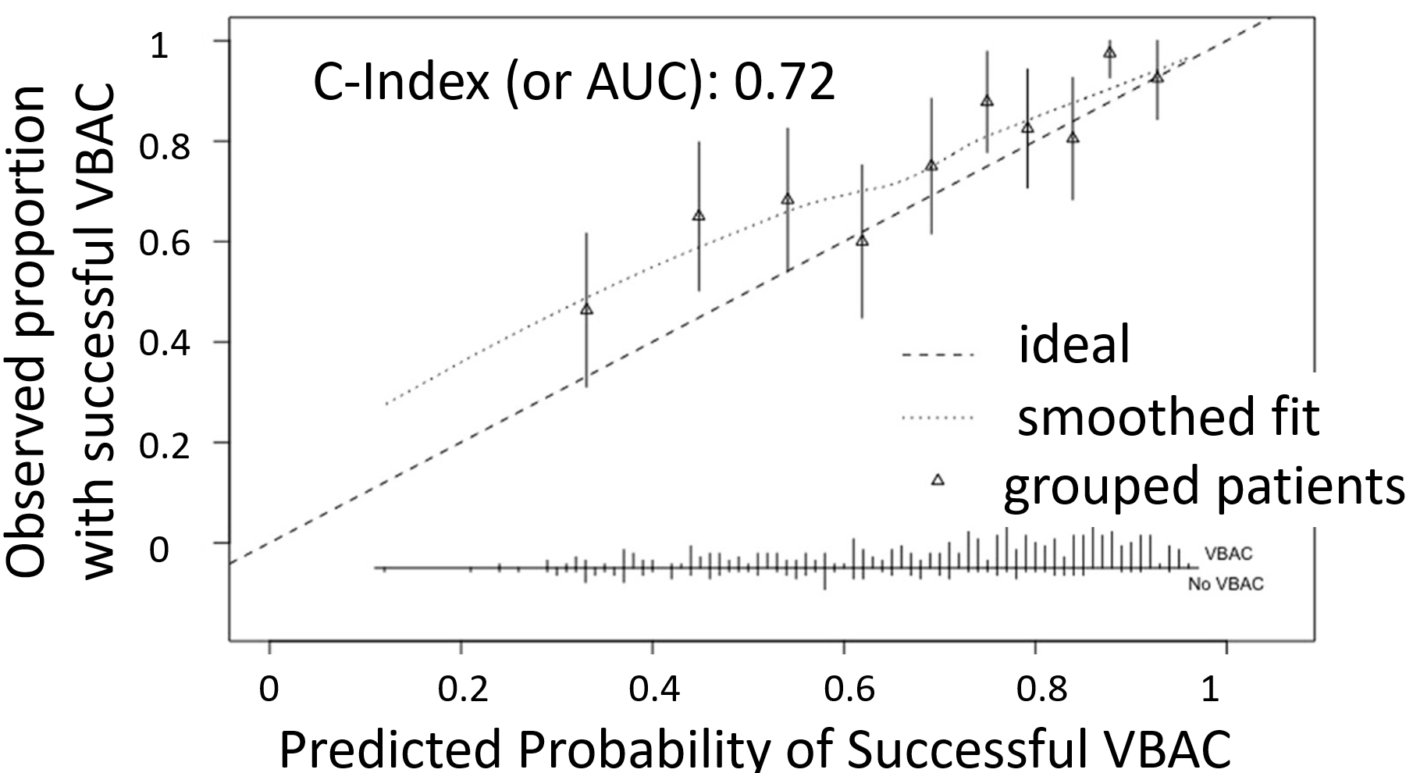
Concluding Thoughts
We need to improve our ability to predict treatment response
Lots of focus on risk/prediction factors, probably not the best approach
Prediction models offer easier path towards personalization
Discussed things to be aware of:
Performance: Both discrimination (numeric) and calibration (visual)
Internal vs. external validation
Inclusion/exclusion criteria
Data collection settings
Feasibility of using model
Intent of authors publishing paper
slides at jimhokanson.com

